Slide 1

Evergreen Housing
Wes Swager

Slide 2
Business Problem
Evergreen Housing is a new house flipping startup looking to establish themselves in the east suburbs of Seattle, Washington.
In order to better assess whether additions which require construction are worthwhile, Evergreen Housing have requested input regarding which features will increase the value of homes and a model predicting pricing.
Notes:
House flipping is purchasing properties with the intent of selling them with the goal of making a profit.
In order to make a profit, most house flips involve improvements to the home which increase the value. However, the cost of these improvements must be accounted for, so earning a profit requires selling for more than the amount paid initially plus plus the cost of the improvements.
The most common improvements will be basic repairs and/or cosmetic renovations, however, for some properties Evergreen Housing may look to make more significant additions to the house via construction.

Slide 3
King County House Sales Data
Data associated with houses sold in King County, Washington between September 9, 2014 and January, 10, 2015.
id - Unique identification number for each house
dateDate - Date sold
pricePrice - Price sold for
bedrooms - Number of bedrooms
bathrooms - Number of bathrooms
sqft_livin - Square footage of house
sqft_lot - Square footage of lot
floors - Number of floors
waterfront - If house has a view to a waterfront
view - If house was viewed
condition - Rating of overall house condition, one-through-five
grade - Grade from King County grading system, one-through-thirteen
sqft_above - Square of house above groun-level, not including basement
sqft_basement - Square footage of basement
yr_built - Year built
yr_renovated - Most recent year renovated
zipcode - Zipcode
lat - Latitude coordinate
long - Longitude coordinate
sqft_living15 - Average square footage of house for nearest fifteen neighbors
sqft_lot15 - Average square footage of lot for nearest fifteen neighbors

Slide 4
Data Cleaning
Remove Fields
Remove features not associated with the physical features of the home: 'id', 'date', 'view', 'sqft_living15', and 'sqft_lot15'
Remove features which cannot be improved through construction: 'waterfront', 'sqft_basement', 'zipcode', 'lat', and 'long'
Remove redundant features: 'sqft_above', in context, is the same as 'sqft_living'
Define and Drop Outliers
Bedrooms > 6 (0.28% of total data)
Bathrooms > 4.5 (0.35% of total data)
Square Footage of the Home > 4,000 (3.21% of total data)

Slide 5
Model and Refine Data
Remove Additional Fields
Remove additional columns based on p-values: Condition, Grade, and Year Built
Remove additional columns based on multicollinearity: Floors
Define and Drop Additional Outliers
Define and drop additional outliers based on QQplot, homoscedasticity, and five-point statistics

Slide 6
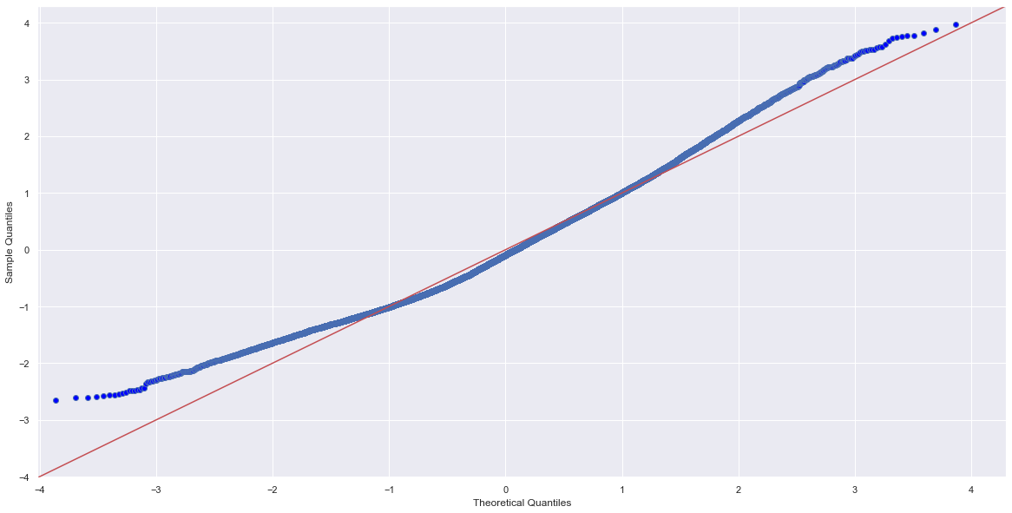
Final Model

Slide 7
Conclusions
In analyzing the data from the houses sold in King County, Washington between September 9, 2014 and January, 10, 2015, the following features show a relationship with increased price (in order of significance):
Square Footage of the Home
Number of Bathrooms
Number of Bedrooms
The recommendation would be, if a house being flipped is being considered for significant additions via construction, that increasing these features.

Slide 8
Conclusions
Surprisingly, it was found that while the grade from King County grading system showed some significance in its relationship with price, that was only the case of higher graded homes, and lower grades showed a less significant relationship. Also, the condition of the home did not show a significant relationship with the price.

Slide 9
Thank You
Email: westin.swager@lsventures.com
GitHub: @wswager
LinkedIn: linkedin.com/in/wes-swager-36a84a2a

